Slide 1
RFID Workshop
Led by Will McGloughlin, Cole Baughman, Amal Alsubaie, and Jackie Cheng

Slide 2
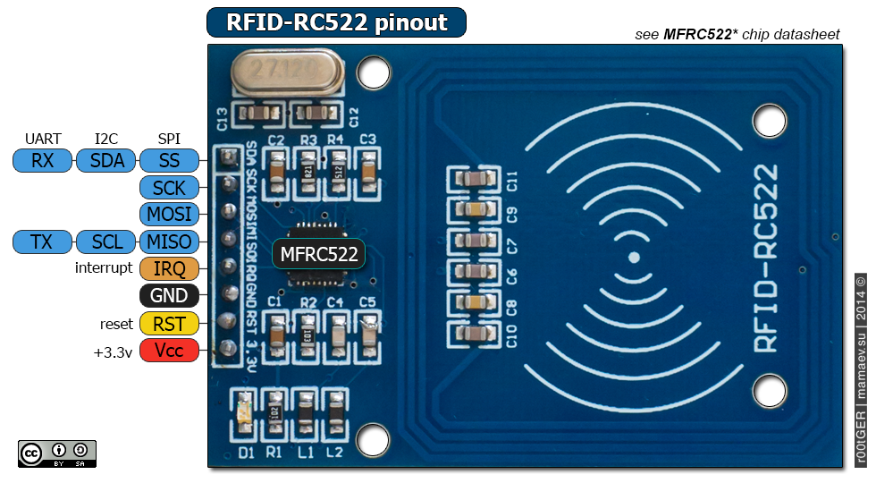
What it is
Radio-frequency identification (RFID) is a technology where we use radio waves to automatically identify or track objects.
RFID Reader (we will be using RFID–RC522)
It generates radio waves continuously and waits to receive data from RFID tag
It uses microcontroller to process the data received.
RFID tag
The tag has the data we want to read. It transmit the data when in range of the RFID Reader.
Active RFID tag: has its own power source
Passive RFID tag: gets power from the RFID reader; the reader radio waves induces current into the tag.
Range and Frequency of operation:
Low Frequency range is up to 10cm
High Frequency range is up to 1m,
Ultra High Frequency range is from 10 to 15m
https://www.abr.com/what-is-rfid-how-does-rfid-work/
https://internetofthingsagenda.techtarget.com/definition/RFID-radio-frequency-identification
https://www.youtube.com/watch?v=Ukfpq71BoMo&ab_channel=ALLABOUTELECTRONICS
https://microcontrollerslab.com/rc522-rfid-reader-pinout-arduino-interfacing-examples-features/
Notes:
Amal

Slide 3
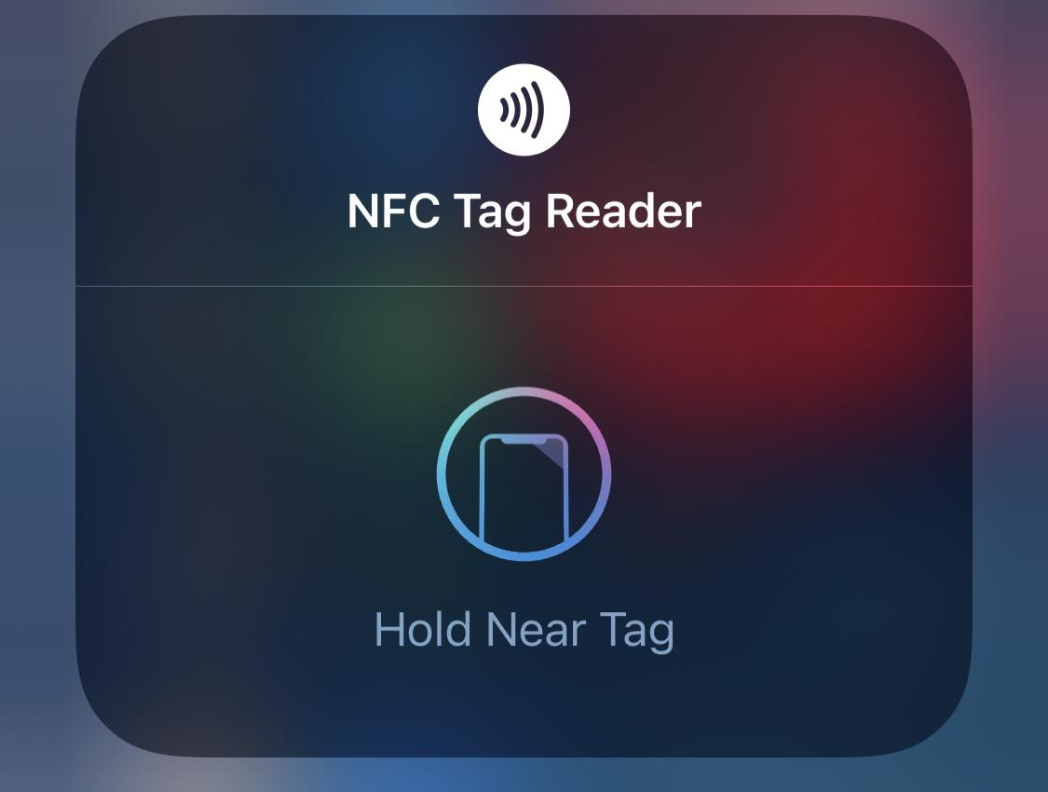
How it works
The RFID reader sends radio waves non–stop with a specific frequency. These waves provide power to the RFID tag, synchronize the clocks, and carrys the data of the RFID tag back into the reader.
For Low and High Frequency tags: Inductive Coupling or Near Field Coupling (NFC)
For Ultra High Frequency tags: Electromagnetic Coupling or Far Field Coupling (FFC)
NFC is the technology used in most of our phones today!
https://www.youtube.com/watch?v=Ukfpq71BoMo&ab_channel=ALLABOUTELECTRONICS
Notes:
Amal

Slide 4
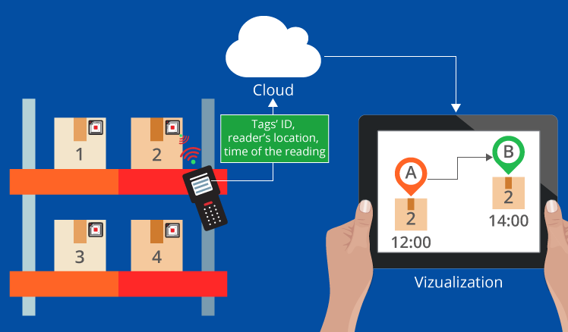
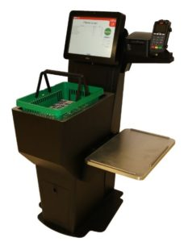
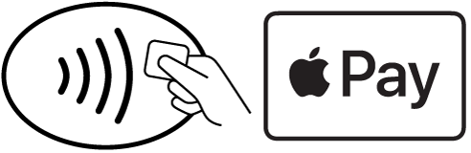
How its used
Self-Checkout
Touchless Payment
Inventory Control
Equipment Tracking
Microchip Implant
Toll Booth Payment
Notes:
Jackie

Slide 5

Programing the Arduino
Arduino IDE supports a dialect of C++, Arduino C
C is a lower level programing language compared to the languages you may know like Python or Java
Python allows us to be more flexible, for example variable types can be determined at runtime by the data assigned to them
C code lacks this flexibility
C must be compiled and uploaded by the IDE to be run on Arduino
We are going to go over some syntax you’ll need to know for your development
Notes:
GBDK for macos:
KiGB: https://www.macupdate.com/app/mac/11018/kigb/download

Slide 6
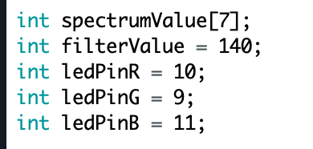
C Syntax - Semicolons and Variable Types
For this workshop we will be using statements similar in nature to ones you know from other programing languages
Syntax of those statements will be different
For example:
Every non blocking statement must end with a semicolon ;
This would not include statements like if or while, the are followed by braces {} containing the statements to be executed by them
Variables must be declared with a type
int x;
int y = 4;
float i = 3.4;

Slide 7
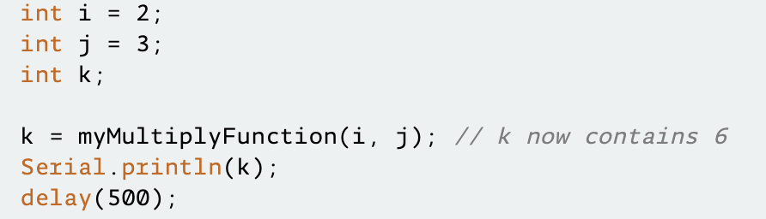
C Syntax - Calling Functions
Calling functions is similar to Java
We will need to supply them with arguments if the function requires them
For example a function with two arguments
function_name(argument1, argument2);
Calling a function with no arguments leaves the parentheses empty
function_name();

Slide 8
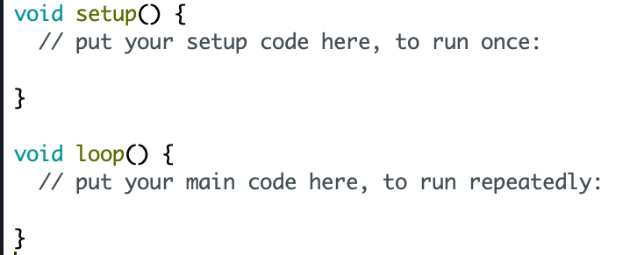
Setup and Loop
When creating a program the Arduino IDE automatically creates two functions
setup() is a place for you to initialize your variables. Runs once.
loop() continuously runs on your Arduino. Runs after setup, forever.

Slide 9
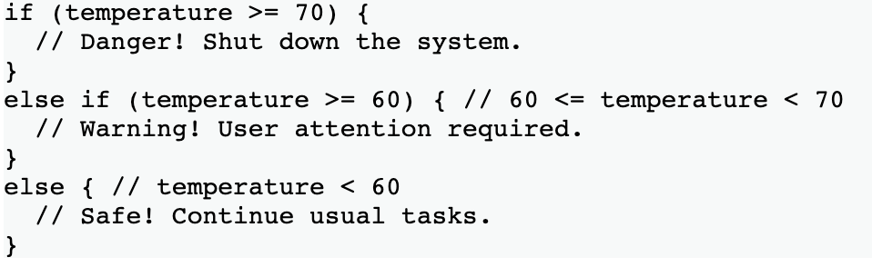
C Syntax - If-else Statements
For this workshop need to know if statements
Similar syntax to Java
Possible conditional operators used in this workshop include
== equals
!= not equal
&& and
|| or
> greater than
< less than

Slide 10
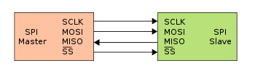
SPI
What is SPI?
Serial Peripheral Interface is a method of short-distance communication, often used with microcontrollers.
How does it work?
SCLK: Serial Clock (output from master)
MOSI: Master Out Slave In (data output from master)
MISO: Master In Slave Out (data output from slave)
CS /SS: Chip/Slave Select (often active low, output from master to indicate that data is being sent)
It’s important to note that only specific arduino pins can perform a given SPI logic signal. Planning ahead on circuit wiring is important!

Slide 11
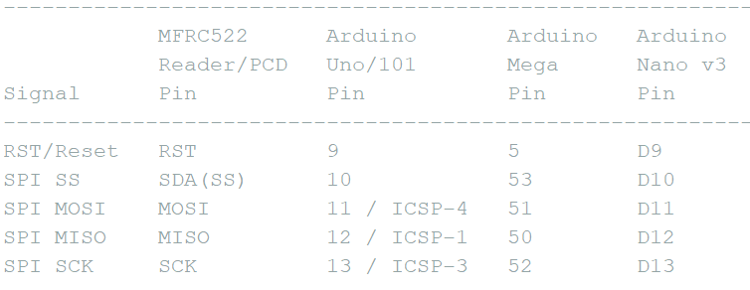
Building the circuit

